Slide 1



Slide 2


ONLINE TAX MANAGEMENT SYSTEM

Slide 3


OUR BIG IDEA
Transforming Online Taxation with Innovation
Simplifying Taxation for a Smarter Tomorrow
Providing Effortless Tax Compliance, Anywhere, Anytime
Empowering You, One Tax Return at a Time.

Slide 4

Group Member Introduction
Group ID | Supervisor Name | VU ID | Student Name
< S24026A86C> | Mam Umra Naeem | BC220402358 BC220402395 | Sadia Bibi Bibi Ateeqa
SUCCESS

Slide 5



Project Introduction
The Online Tax Management System is a modern solution designed to simplify and streamline the tax collection and management process for both taxpayers and tax authorities. It provides a user-friendly platform that reduces the complexity of tax compliance by automating tax calculations, payment processing, and filing. The system aims to enhance efficiency, accuracy, and convenience for all users, ensuring a smooth and hassle-free experience.
For taxpayers, the system offers a convenient interface to file their taxes, update their tax-related information, and securely upload required documents. It eliminates the manual effort associated with traditional tax filing by automating most tasks. Additionally, the system provides real-time notifications and reminders to keep taxpayers informed about updates, deadlines, and payment statuses
Tax authorities benefit from a secure backend that allows for the efficient management of taxpayer data, payment processing, and regulatory updates. The system features advanced reporting tools to generate insights and analytics, enabling better decision-making and regulatory compliance. Administrative functions, such as updating tax rates and sending notifications, further streamline operations for tax officials.

Slide 6

Project Introduction
Security and data privacy are core priorities of the Online Tax Management System. It employs robust encryption, firewalls, and compliance with global standards like GDPR and CCPA to ensure the confidentiality and safety of taxpayer information. Users can trust that their sensitive data is protected against cyber threats and unauthorized access.
The system is designed to support multiple functional requirements, including user registration, document management, payment processing, and tax data management. Taxpayers can securely manage their accounts and complete tax-related tasks, while authorities can oversee and maintain the entire tax management ecosystem. By automating manual processes, the system significantly reduces errors and improves operational efficiency.
In conclusion, the Online Tax Management System is a comprehensive and integrated solution that addresses the needs of both taxpayers and tax authorities. Its advanced features, focus on security, and user-centric design make it an ideal platform to modernize and simplify tax management processes. It aims to build trust, ensure compliance, and improve the overall tax collection experience.

Slide 7



SERVICES WE OFFER
Smart Tax Applications
Efficient Document Processing
Automated Tax Calculation
Insightful Reporting
Secure Payment
Real Time Custom Notifications
Automated Reminders
Admin Control Hub

Slide 8


BUSINESS REQUIREMENTS
FR01: User Registration:
All users should enter a username first and last
name and password, email address etc. for signup.
FR02: Tax Data Entry and Management:-
Users should be able to input and update their tax-related information.
There should be different interactive forms for different tax categories
(income tax, property tax, sales tax, etc.).
FR03: Document Management:-
Taxpayers should be able to upload necessary documents for tax filing.
Automated verification of uploaded documents for accuracy.
Easy retrieval of past tax documents for reference.
FR04: Automated Tax Calculation:-
System should calculate taxes based on tax payer’s inputs.
Generation of tax reports, summaries, and statements.

Slide 9
BUSINESS REQUIREMENTS
FR05: Payment Module
The system should allow Secure payment for tax payments.
There should be multiple payment methods (credit/debit card, bank transfer)
FR06: Reporting and Analytics
Tax Reports: Generation of tax reports for tax payers and authorities.
FR07: Notifications and Alerts:-
Automated Alerts: System should send reminders for tax deadlines and updates.
Custom Notifications: Admin should set up custom alerts for specific tax events.
FR08: Administrative Functions:-
Tax Rate Management: Admin will create and update tax rates and regulations.
Tax Payer Account Management: Admin will manage taxpayer accounts.

Slide 10


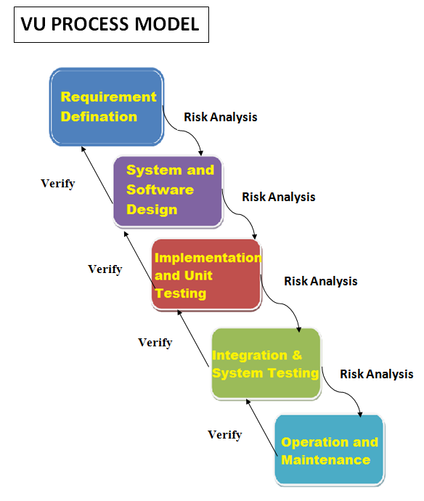
BUSINESS PROCESS MODEL
Description
The VU Process Model is a hybrid software development methodology that incorporating iterative cycles for continuous feedback and risk assessment. This approach aims to enhance system quality and minimize risks throughout the development process.

Slide 11


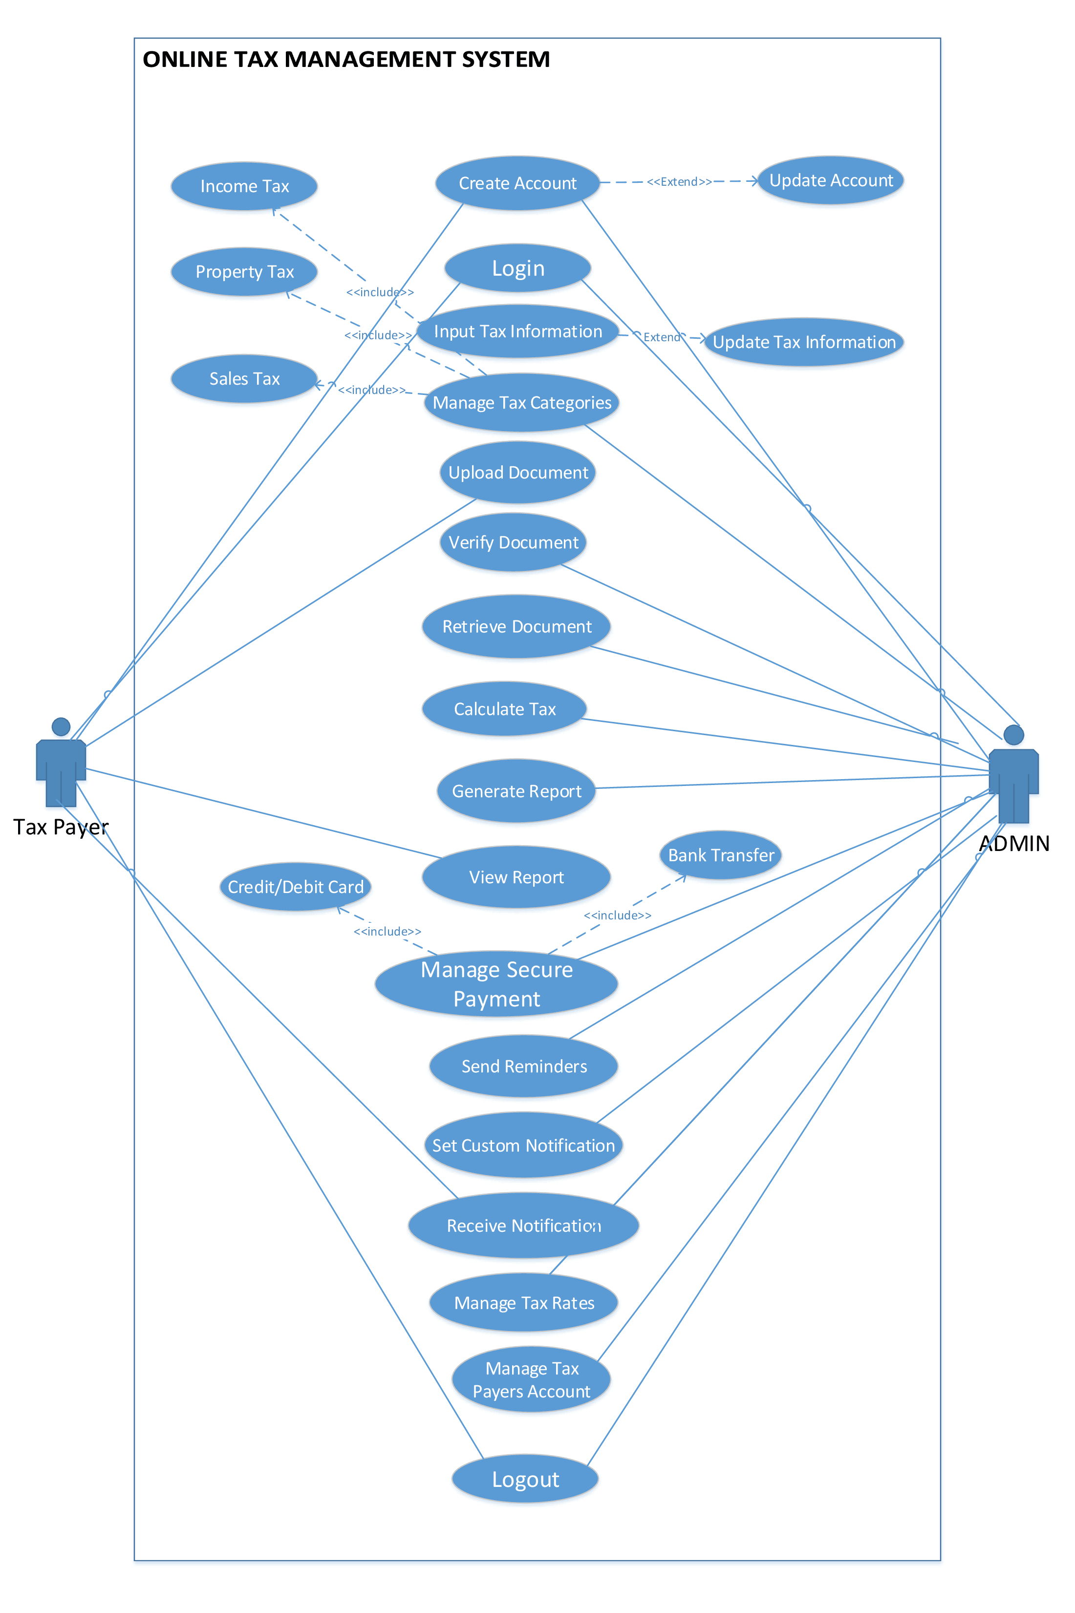
USE CASE MODEL DIAGRAM
Description
A visual representation of system interactions, illustrating users and actions to identify functional requirements.
It models the system's behavior, capturing the who, what, and how of system usage.

Slide 12

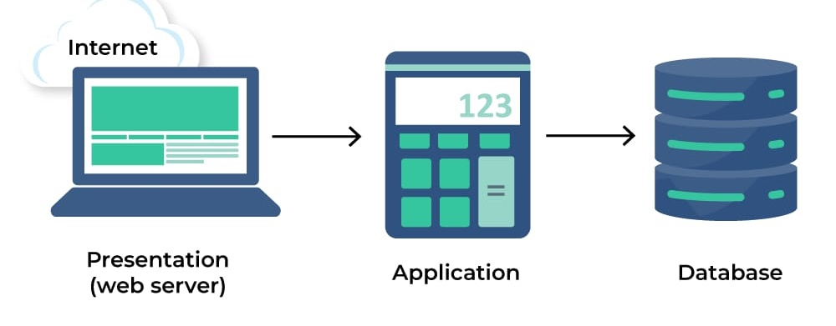

Language Used
ARCHITECTURAL DESIGN
Three Tier Architecture
Frontend Language
HTML
CSS
Bootstrap
Backend Languages
PHP PDO
Database
MYSQL

Slide 13



THE TEAM
Sadia Shezadi
Member 1
Ateeqa Kashmala
Mamber 2
Mam Umra Naeem
Supervisor

Slide 14

PROJECT ROADMAP(PHASES APPRACH)
Software Requirement Specifications
Design Document
Entity Relationship Diagram
Testing
(Prototype)
Basic Structure Of Application
Class Diagram
Database Diagram
Test Cases
Final Deliverable
Sequence Diagram
Prototype Viva
Grant chart
Usage Scanerios
Business model(VU Process)
UC Diagram
Requirements
Application Source Code
Final Presentation
Final Report

Slide 15
KEY TIMELINE GOAL
29/4/2024 TO
20/5/2024
21/5/2024
TO
11/7/2024
12/7/2024
TO
29/8/2024
29/8/2024
TO
20/11/2024
Task Names
1.Software Requirement Specifications
2.Documentation Design
3.Prototype Phase
4.Final Deliverable

Slide 16
Detailed Project Plan
Description
A project management diagram displaying tasks, dependencies, and timelines to visualize and track project progress.

Slide 17

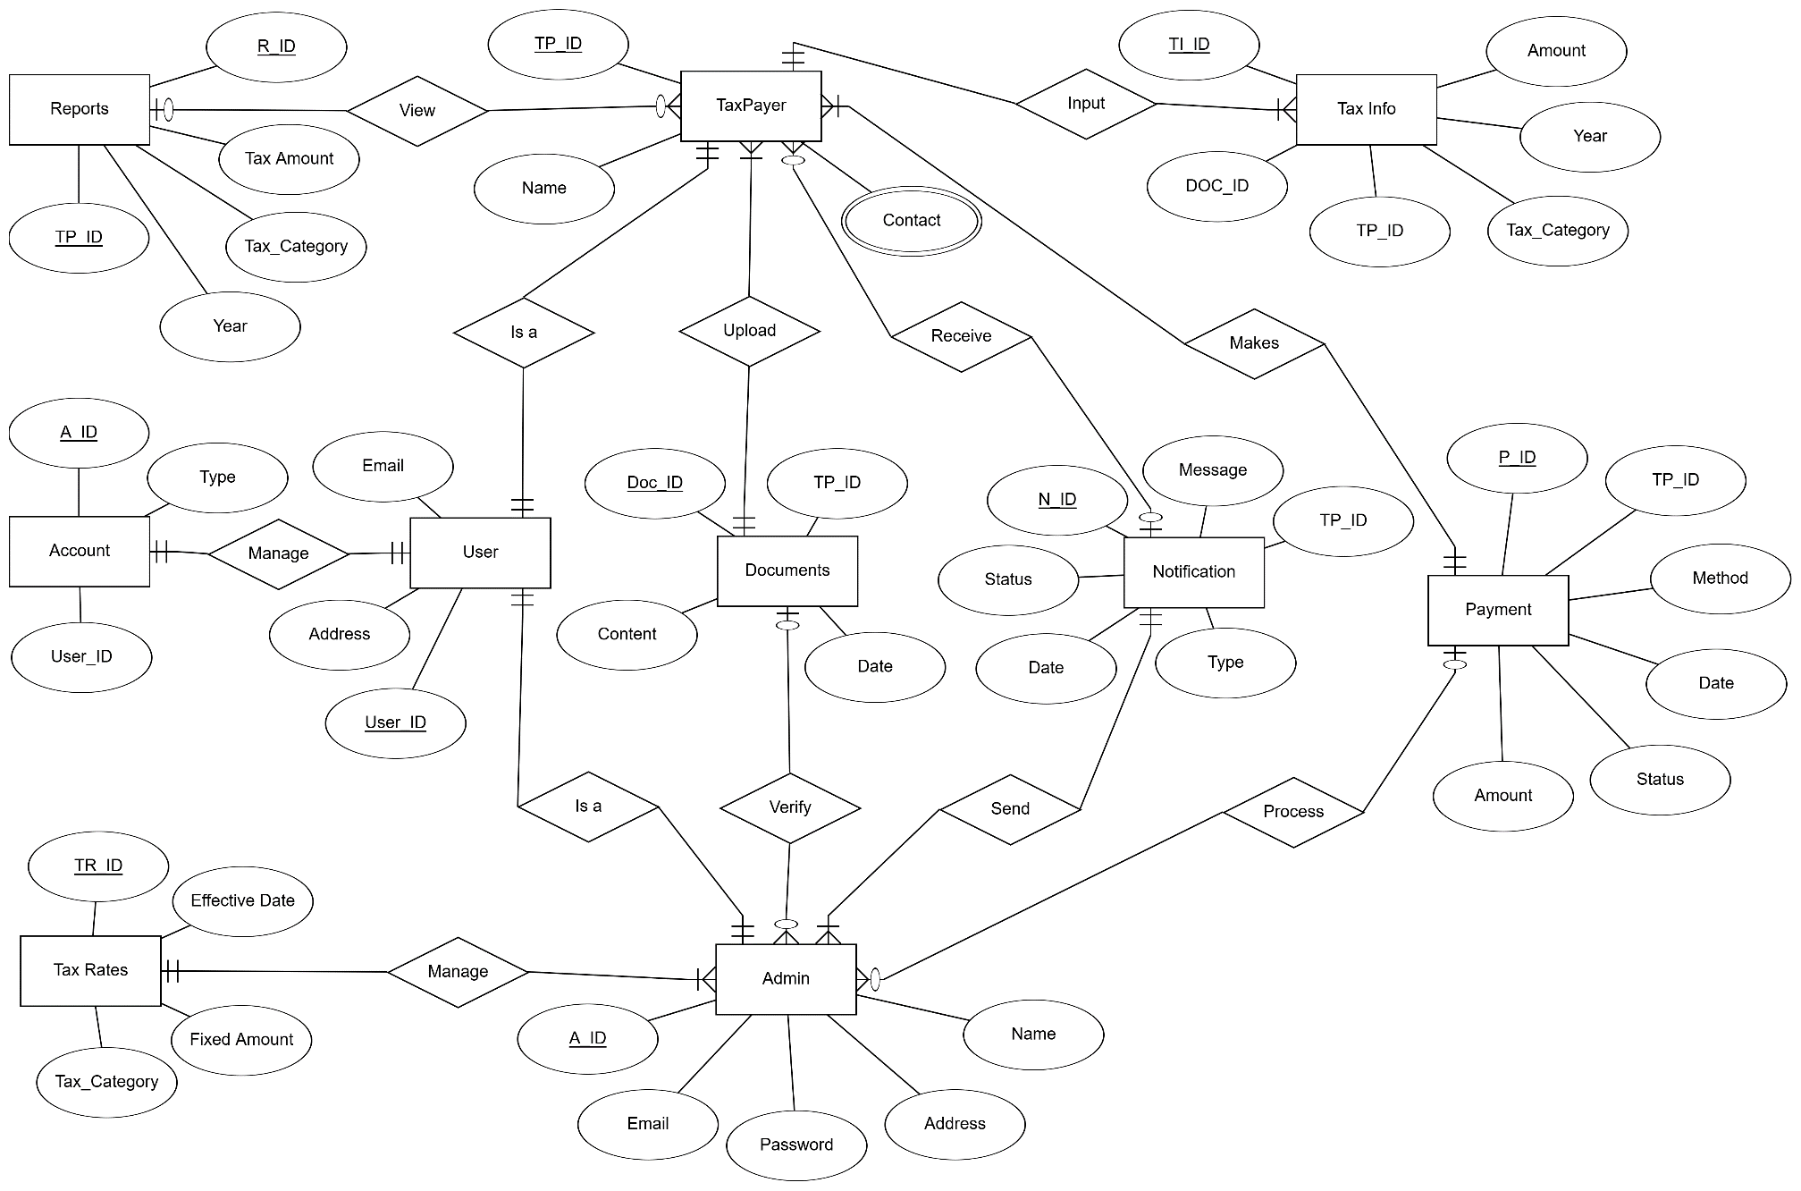
ENTITY RELATIONSHIP DIAGRAM
Description
This diagram Models data entities and their relationships.
It Defines database schema and structure.
It Guides data management and analysis.

Slide 18
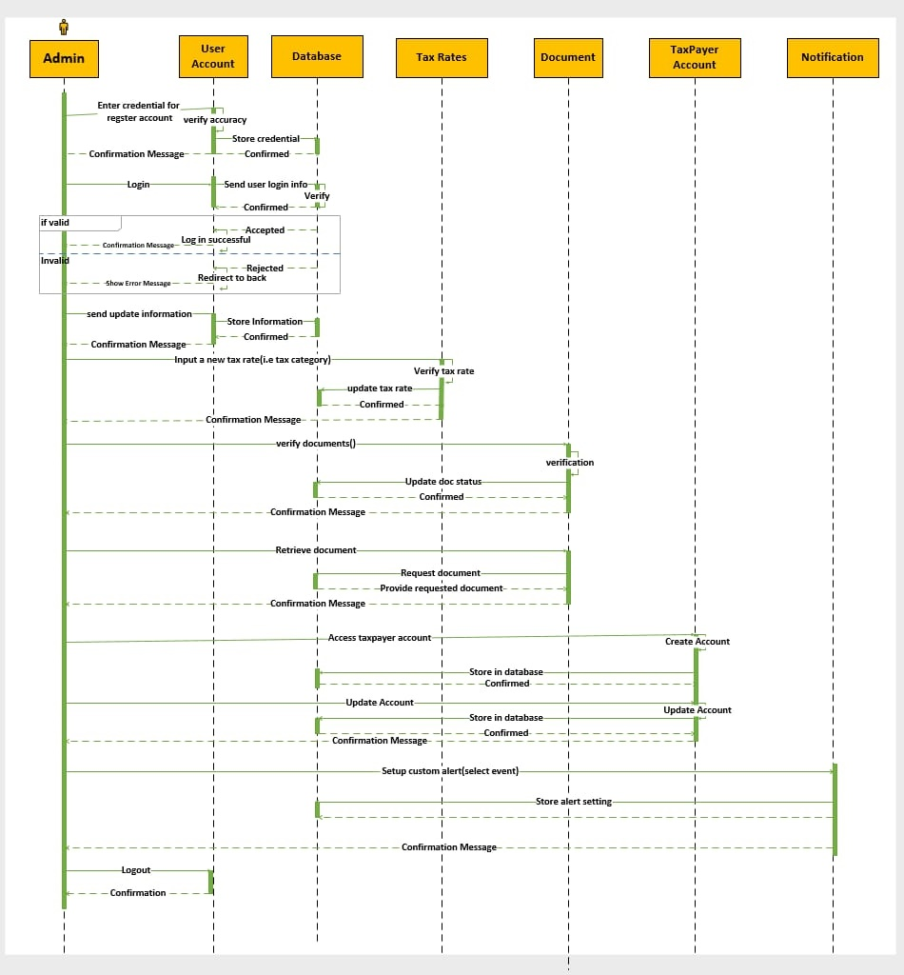
SEQUENCE DIAGRAM(Admin)
Description
This Diagram Illustrates the sequence of interactions between taxpayer and system, showcasing the steps involved in submitting and processing of Tax Applications.

Slide 19

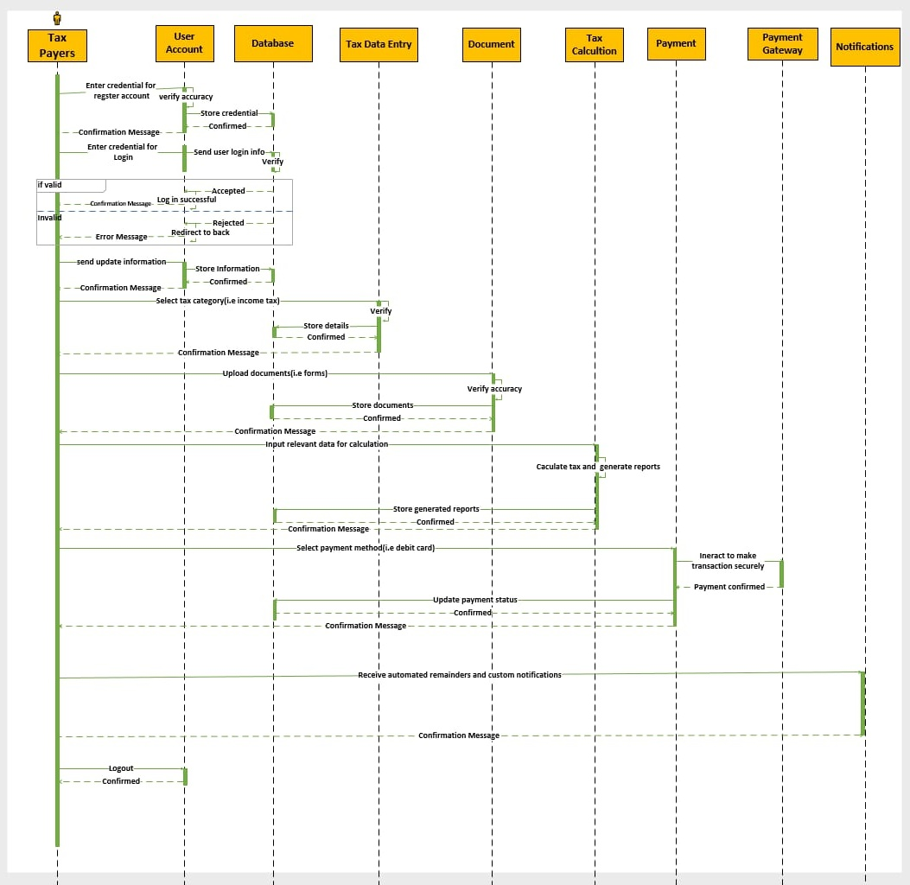
SEQUENCE DIAGRAM(TaxPayer)
Description
This diagram Depicts the sequence of interactions between admin and system, highlighting the steps involved in managing taxpayer data and processing tax Applications.

Slide 20

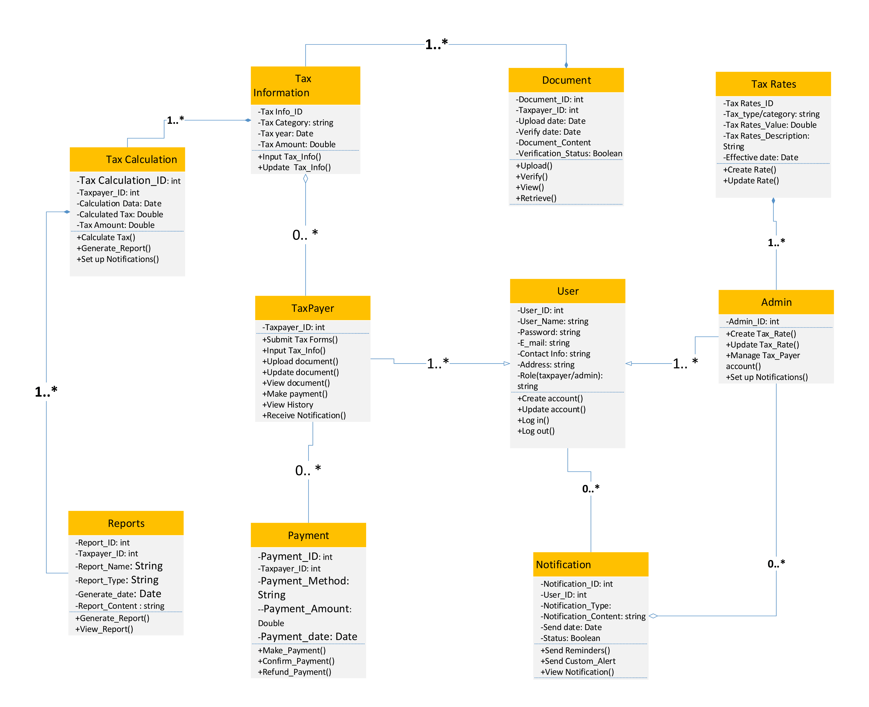
LOGICAL MODAL / CLASS DIAGRAM
Description
A logical diagram of system classes, attributes, behaviors and relationships, defining the system's object-oriented structure.

Slide 21
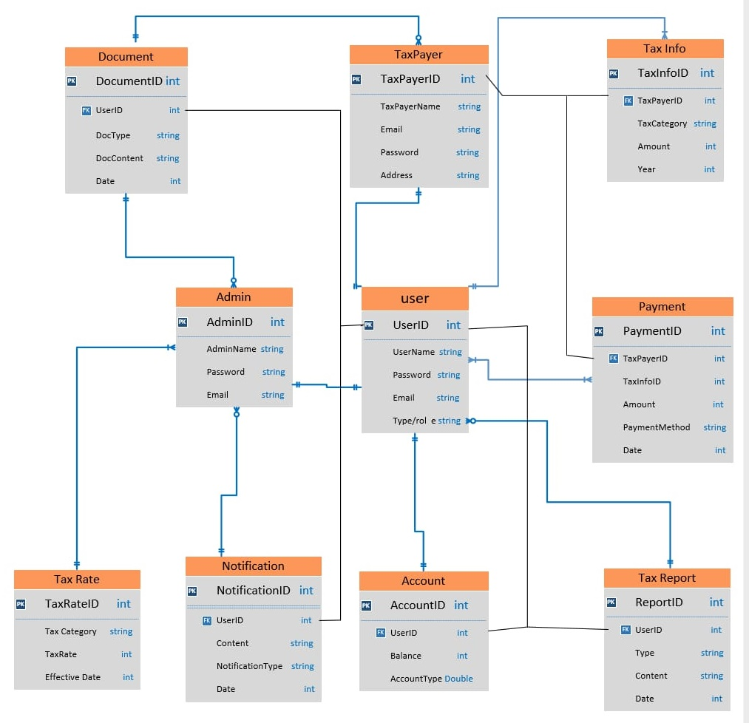
DATABASE DIAGRAM
Description
Represents database structure and organization.Illustrates table relationships and data flows.Guides database design and development.

Slide 22

GRAPHICAL USER INTERFACE (Home Page)

Slide 23
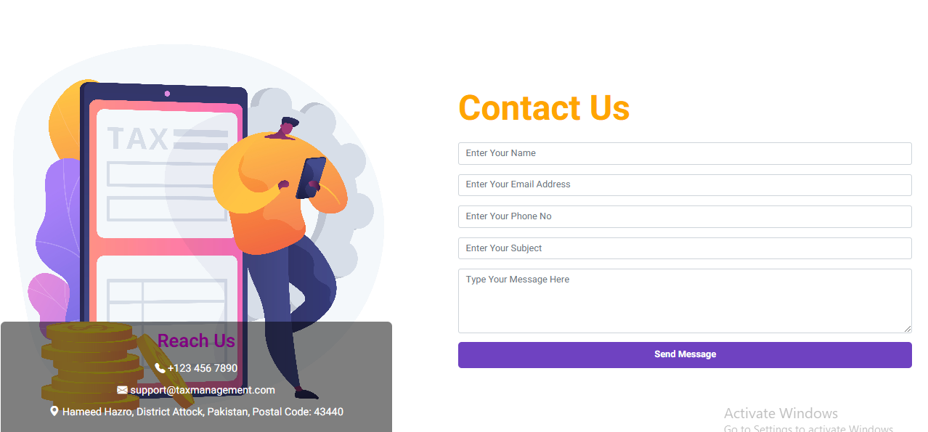


Slide 24
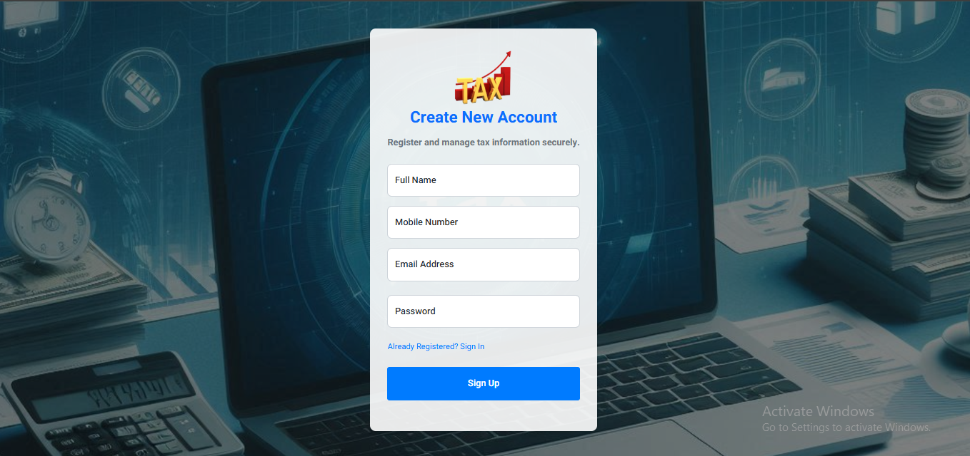
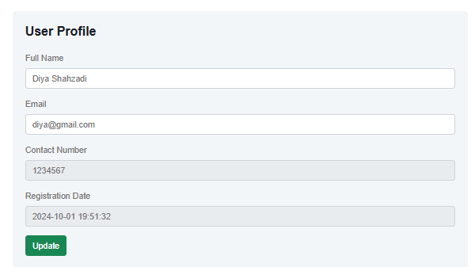
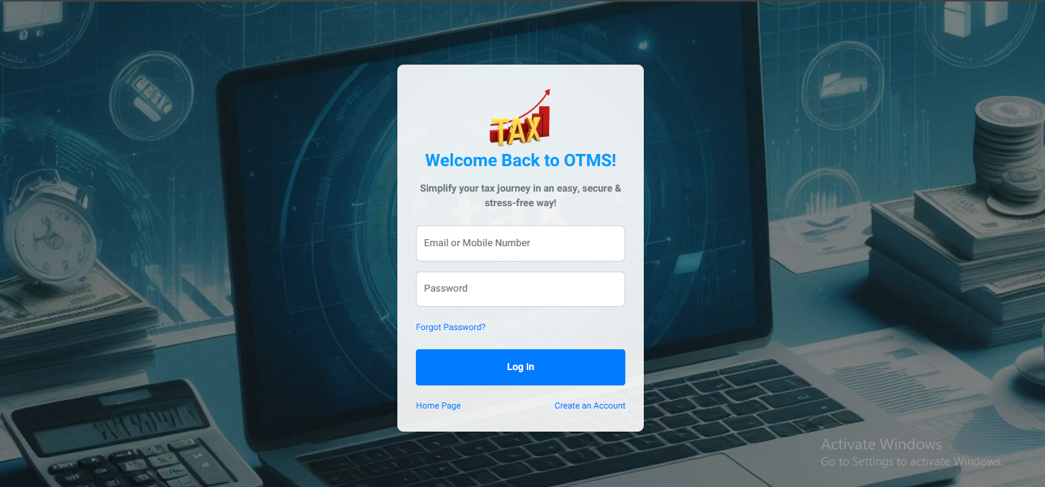
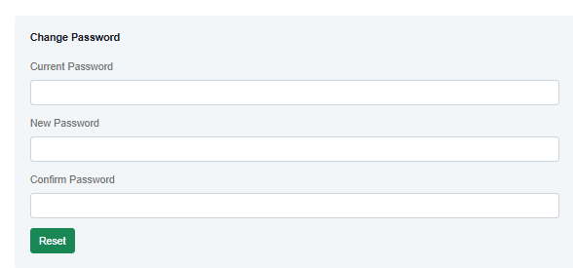
FR1(GUI): USER REGISTRATION

Slide 25
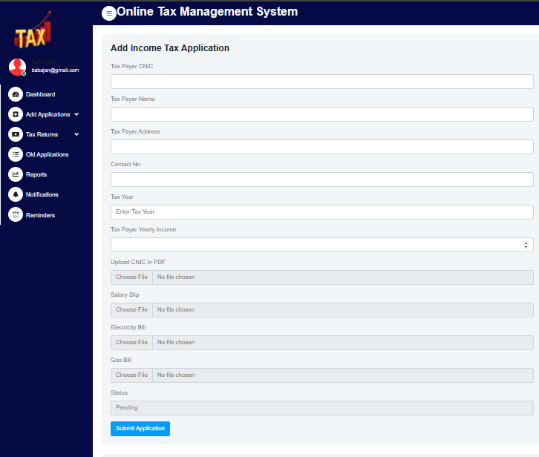
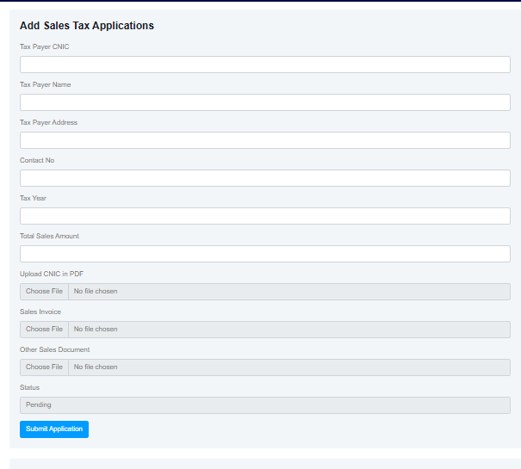
FR2(GUI): TAX DATA ENTRY

Slide 26
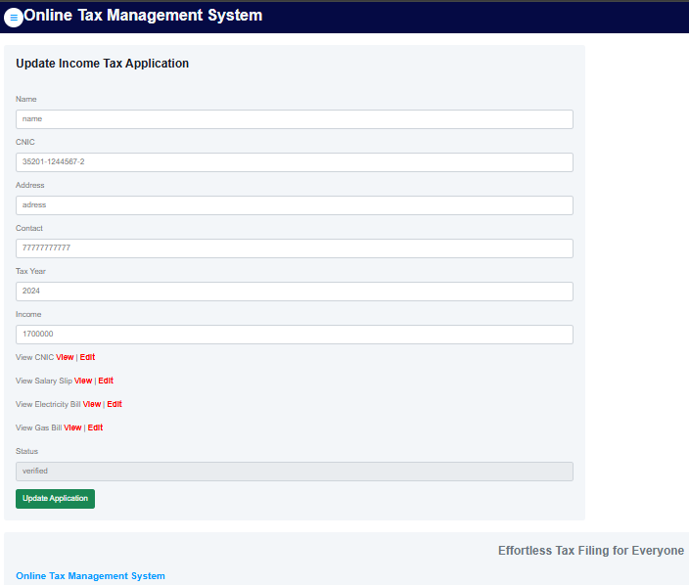
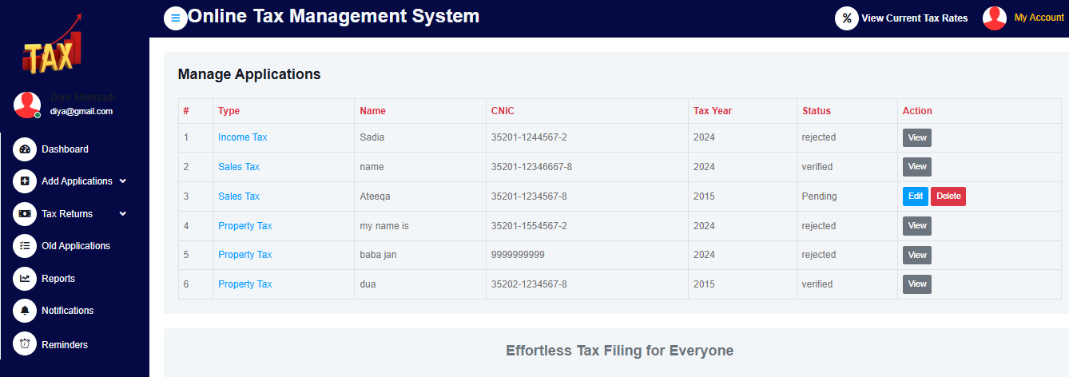
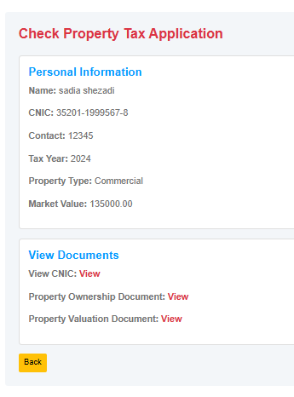
FR2(GUI): TAX DATA MANAGEMENT

Slide 27
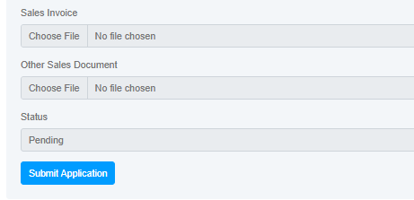
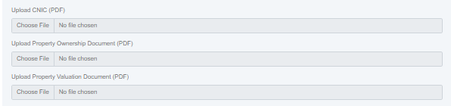
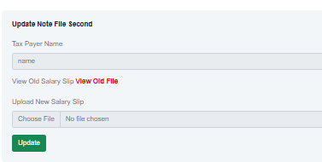
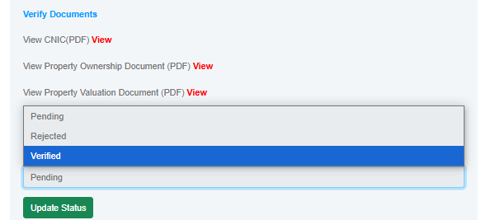
FR3(GUI): DOCUMENT PROCESSING

Slide 28
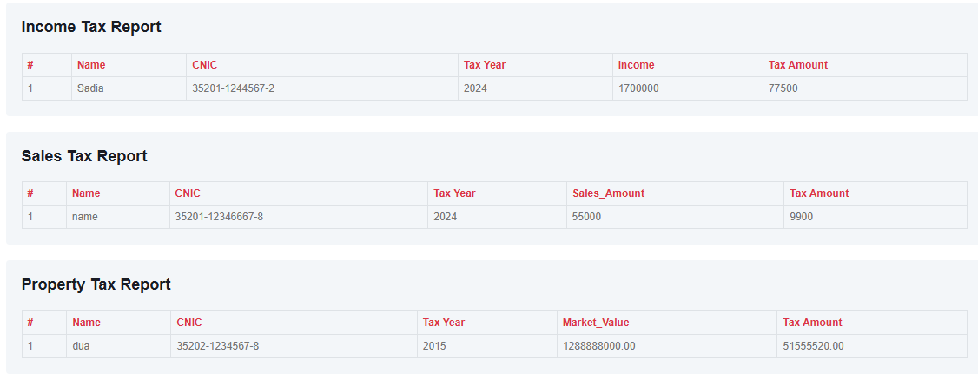
FR4(GUI): AUTOMATED TAX CALCULATION

Slide 29
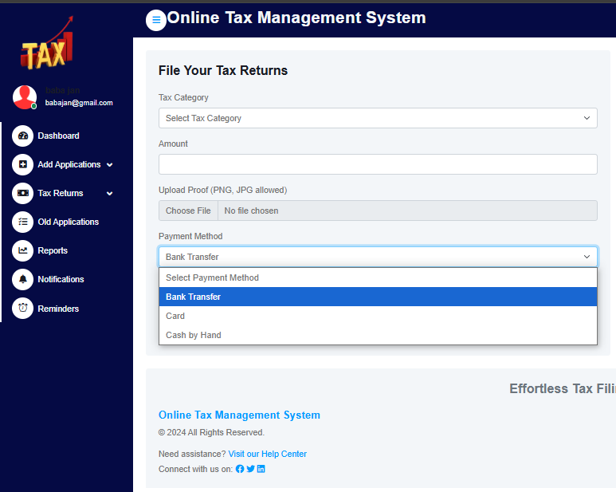
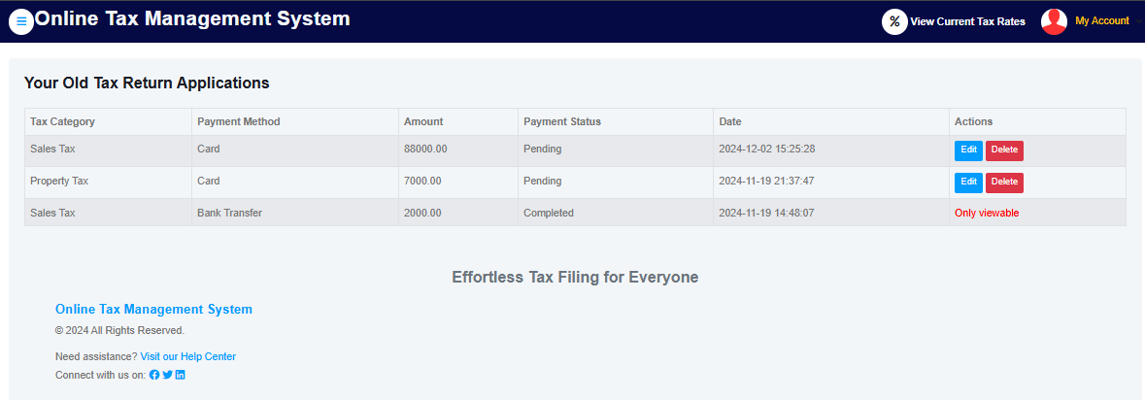
FR5(GUI): PAYMENT MODULE

Slide 30
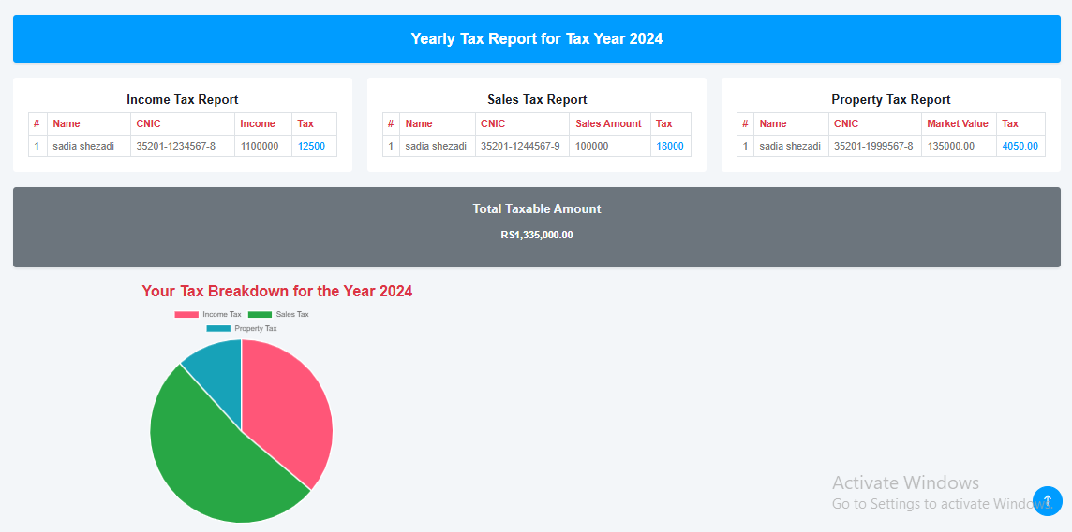
FR6(GUI): REPORTING AND ANALYTICS

Slide 31
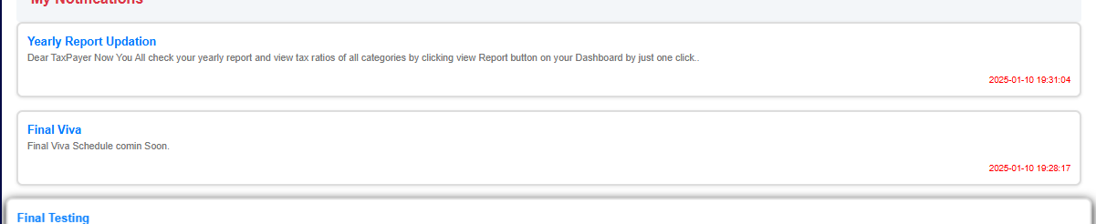
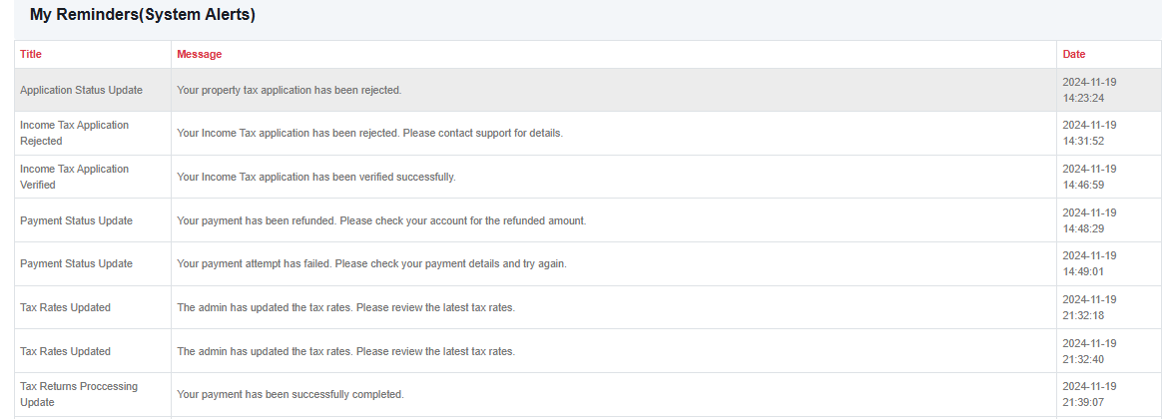
FR7(GUI): NOTIFICATIONS AND ALERTS

Slide 32
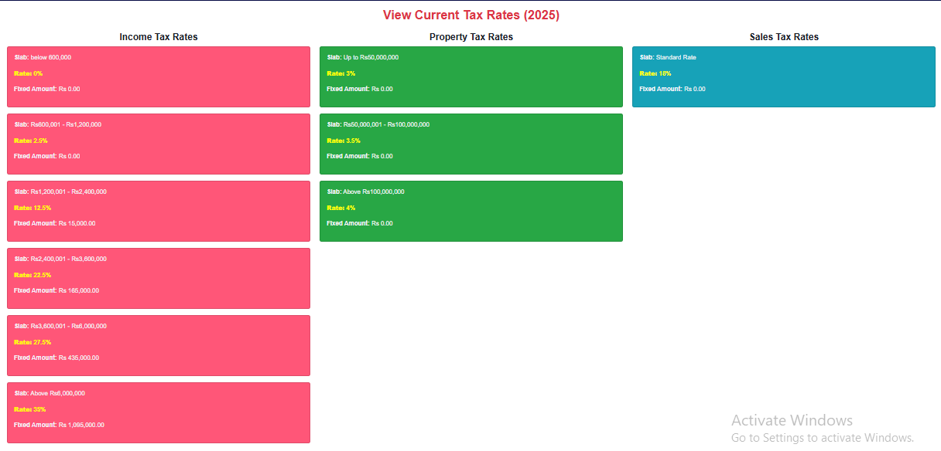
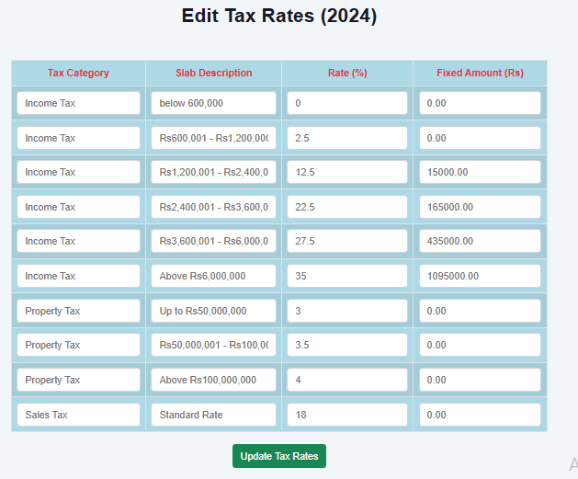
FR8(GUI): TAX RATES MANAGEMENT

Slide 33
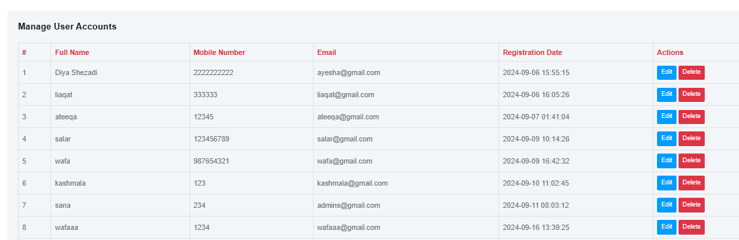
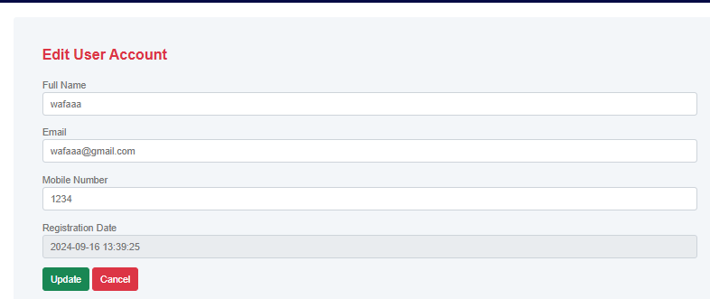
FR8(GUI): TAXPAYER MANAGEMENT

Slide 34
Defination, acronyms & abbrevation
(Hyper Text Markup Language)
(Cascading Style Sheet)
(PHP Data Objects)
HTML
(Database Management System)
(Structure Query Language)
Bootstrap V5
CSS
DBMS
PDO
SQL
Bootstrap

Slide 35
LANGUAGES & TOOLS USED
MS Visio 2016
Sublime Text Editor
XAMPP Control Panel v3.2.4
Microsoft Word 2013
Microsoft Excel 2013
Microsoft Power Point 2013
MY
SQL
PHP
HTML,CSS
FINAL APPLICATION

Slide 36




FOR YOUR TIME!!
Sadia Shezadi
Ateeqa Kashmala
OnlineTaxSys@gmail.com
111-436-700

